Slide 1
The Eurozone Debt Crisis Ten Years Later
IEEI Colloquium, Cologne, June 12-14, 2019
Presentation by Steven T. Kargman and Christoph Paulus

Slide 2
Outline of Presentation
Part I: Eurozone Then and Now
Part II: Major Legal and Policy Issues Raised During the Eurozone Crisis
Part III: Efforts to Strengthen the Institutional Framework for Addressing Future Debt Crises
Part IV: Current Concerns in Eurozone

Slide 3
Eurozone Then and Now (cont’d)

Slide 4
Eurozone Then and Now (cont’d)

Slide 5
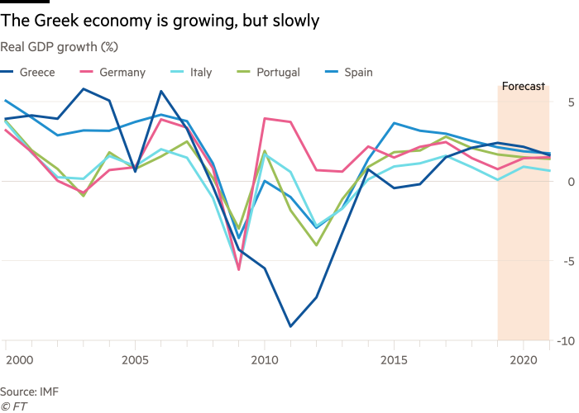
Part I—Eurozone Then and Now (Focus on Greece Relative to Other Eurozone Countries)
Source for Following Charts (except as otherwise noted): Financial Times, “Greek economy shows promising signs of recovery,” May 19, 2019

Slide 6
Eurozone Then and Now (cont’d)

Slide 7
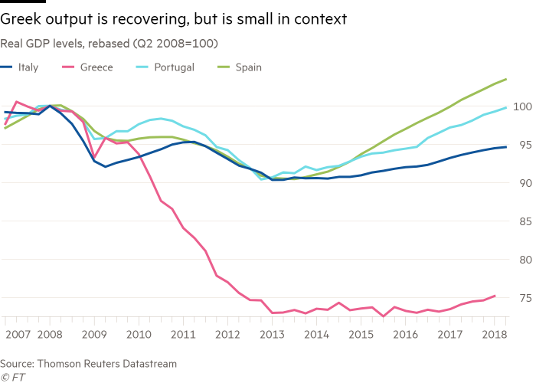
Eurozone Then and Now (cont’d)
Source: Financial Times, August 18, 2018

Slide 8
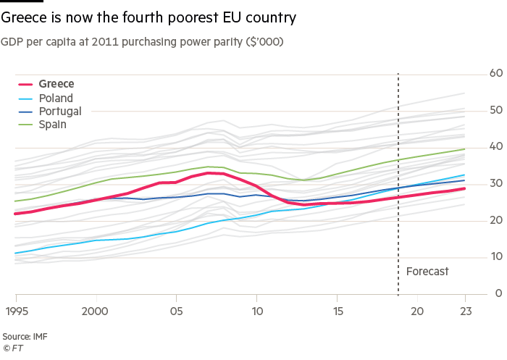
Eurozone Then and Now (cont’d)
Source: Financial Times, “In charts: Greece’s economy is rebounding — but there is far to go,” Aug. 18, 2018

Slide 9
Eurozone Then and Now (cont’d)

Slide 10
Eurozone Then and Now (cont’d)

Slide 11
Part II—Major Legal and Policy Issues Raised During the Eurozone Crisis
Greece: Legality of ‘Retrofitting’ of Bonds with Collective Action Clauses by Unilateral Act of Greek Parliament
According to the Court, the Greek government could have “legitimately taken action to maintain action to maintain economic stability and restructure the debt in the in the general interests of the community….” (Mamatas and Others v. Greece, European Court of Human Rights, ECHR 256 (2016))
Court considered the “proportionality of the interference” by the Greek government: “…the impugned measures had not been disproportionate to their legitimate aim and that there had been no violation of Article 1 of Protocol No. 1 (protection of property)….”
Mamatas and Others v. Greece, European Court of Human Rights, (2016)
Cyprus: Bailing in of Bank Depositors with Deposits Above 100k euros
Court of Justice of the European Union

Slide 12
Part II—Major Legal and Policy Issues Raised During the Eurozone Crisis (cont’d)
Ireland: Decisions taken by government and banks affecting legal rights of creditors
Subordinated Liability Orders: Subordination of Sub Debt Holders to Pref Shareholders—i.e, subordinating debt to equity
Exit Consents and “Oppression of Minority Bondholders”
the exchange ratio for redemption was set as follows: for every €1000 in face value of bonds, a bondholder would receive €.01
a hedge fund, Assenagon Asset Management, which later brought suit, held bonds with a face value of €17 million, but under the redemption scheme set forth in the exit consent, would have received only €170 of bonds
Assenagon Asset Management SA v. Irish Bank Resolution Corp. Ltd. (formerly Anglo Irish Bank Corp. Ltd.), UK High Court of Justice

Slide 13
Part II—Major Legal and Policy Issues Raised During the Eurozone Crisis (cont’d)
Ireland: Sweeping Powers of National Asset Management Agency (NAMA) set up in aftermath of Irish crisis—upheld but subject to due process (right to be heard)
e.g., Delway Investments Limited, etc. v. National Asset Management Agency, Ireland and the Attorney General, Irish Supreme Court
Germany: Authority of Bundestag to Commit Funds to Bailouts (German Constitutional Court)

Slide 14
Part II—Major Legal and Policy Issues Raised During the Eurozone Crisis (cont’d)
Other Matters
Debate over austerity versus growth-oriented policies
Contrasting approaches: Greece (austerity policies prescribed by official sector) versus Portugal in recent years (growth policies)
Spillover from banking sector travails to sovereign distress
e.g., Iceland (non-eurozone), Ireland, Cyprus, etc.
Property lending as a key part of banking sector problems in certain countries, especially where there is a boom (and then bust) in property prices
Note different approaches to resolving problems in banking
e.g., nationalization of banks in Iceland, etc.

Slide 15
Part II—Major Legal and Policy Issues Raised During the Eurozone Crisis (cont’d)
Impact of distress of sub-sovereign entities on sovereign—e.g., Spain
De facto subordination of bonds held by ordinary creditors vis-à-vis bonds purchased by ECB (due to ECB’s claimed preferred creditor status)

Slide 16
Part III—Efforts to Strengthen the Institutional Framework for Addressing Future Debt Crises
Collective Action Clauses: Mandatory insertion of collection action clauses in bonds of greater than one-year maturity issued by eurozone sovereigns post-January 1, 2013
European Stability Mechanism: Creation of European Stability Mechanism (ESM) and predecessor institutions (e.g., EFSF) to provide firepower for dealing with financial crises
Issue: Would its resources be adequate to deal with an Italy-type crisis?
Governance issues re ESM (even with proposed reforms): e.g., still unanimity requirement (therefore dependent on political mood in respective state capitals), contagion still hard to contain, etc.
ECB response to threat of contagion: Draghi (July 26, 2012) —“Do whatever it takes…..”
curtain-raiser to massive ECB bond-buying program
Single Resolution Mechanism: Creation of Single Resolution Mechanism (SRM) for bank resolution in EU (in the context of the creation of a banking union)

Slide 17
Part IV—Current Concerns in Eurozone
Italy (third largest economy in eurozone)—is there enough existing firepower to contain any potential Italian financial crisis?
huge stock of outstanding debt—over 2 trillion dollars
high debt to GDP ratio—132% in 2018
high unemployment—10.7% in Feb. 2019
sluggish growth—0.1% projected for 2019
large budget deficits-projected to be 2.5% of GDP for 2019 (OECD)
relatively high level of NPLs—roughly one-quarter of eurozone total
political issues:
Growing split between Italy and European Commission on budget deficit and debt issues—possibility of “excessive debt procedures” vis-à-vis Italy
Questions regarding political leadership
Outlook after European elections that were held on May 26 (i.e., strength of Legal Nord in election results, etc.)

Slide 18
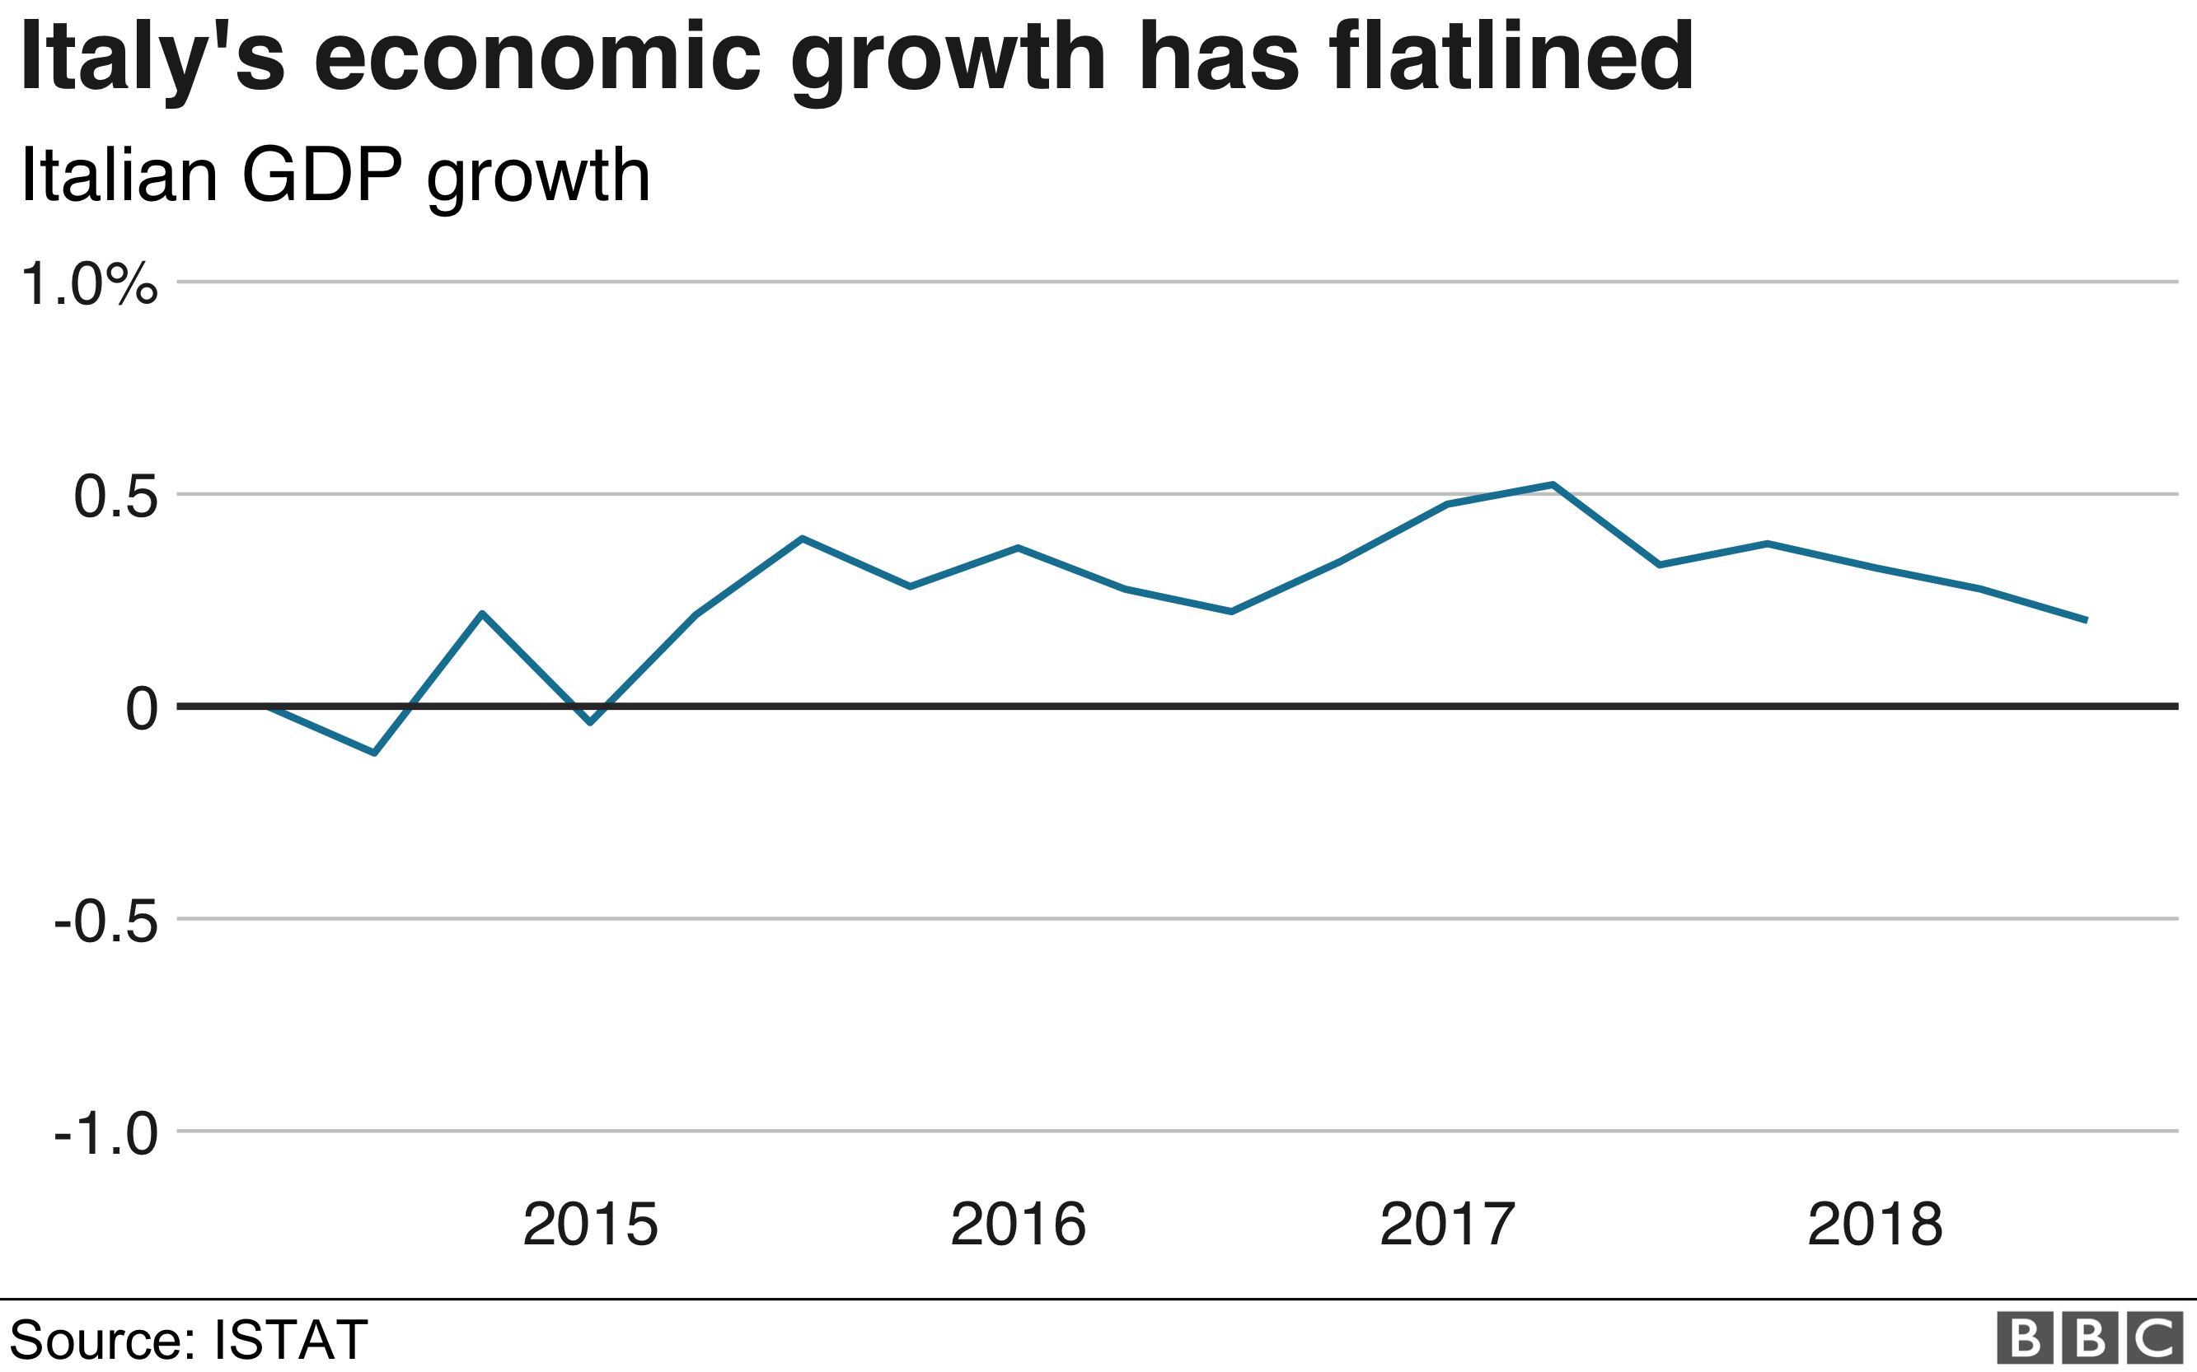
Current Concerns in Eurozone (cont’d)
Source for Charts on Italy: BBC, “What's behind Italy's economic turbulence?,” Oct. 5, 2018

Slide 19
Current Concerns in Eurozone (cont’d)

Slide 20
Current Concerns in Eurozone (cont’d)

Slide 21
Current Concerns in Eurozone (cont’d)
Greece
NPLs: continuing major overhang of non-performing loans (NPLs)
85 billion euros of non-performing exposures
One-half of Greece’s forecast GDP for 2019
Represent approximately 45% of outstanding bank loans
Banks have been directed by Single Supervisory Mechanism to shed major portion of NPLs in the next few years
Banks have agreed to cut bad loan portfolios by more than 60b euros by end of 2021, with the aim of leaving NPLs below 20%
Note: Debt auctions being held by Greece’s major banks in order to remove NPLs from their balance sheets

Slide 22
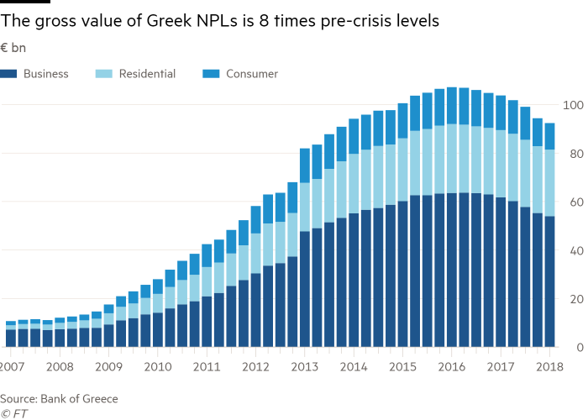
Current Concerns in Eurozone (cont’d)
Source: Financial Times, “In charts: Greece’s economy is rebounding — but there is far to go,” Aug. 18, 2018

Slide 23
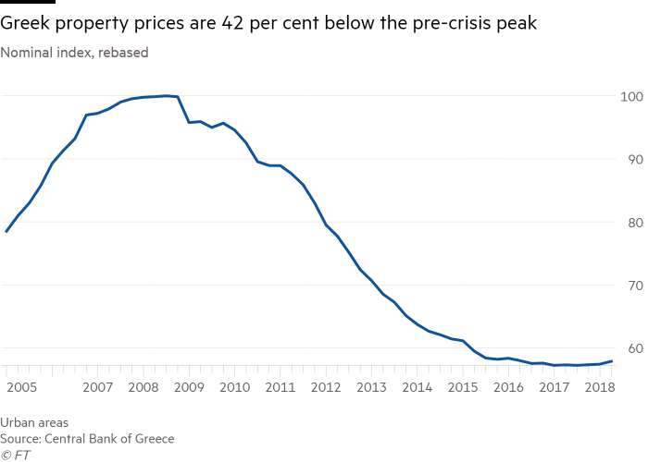
Current Concerns in Eurozone (cont’d)
Source: Financial Times, “In charts: Greece’s economy is rebounding — but there is far to go,” Aug. 18, 2018

