Slide 1
Restructuring & Insolvency – Current trends & topics in Germany IEEI London 2023
Dr. Sven-Holger Undritz

Slide 2
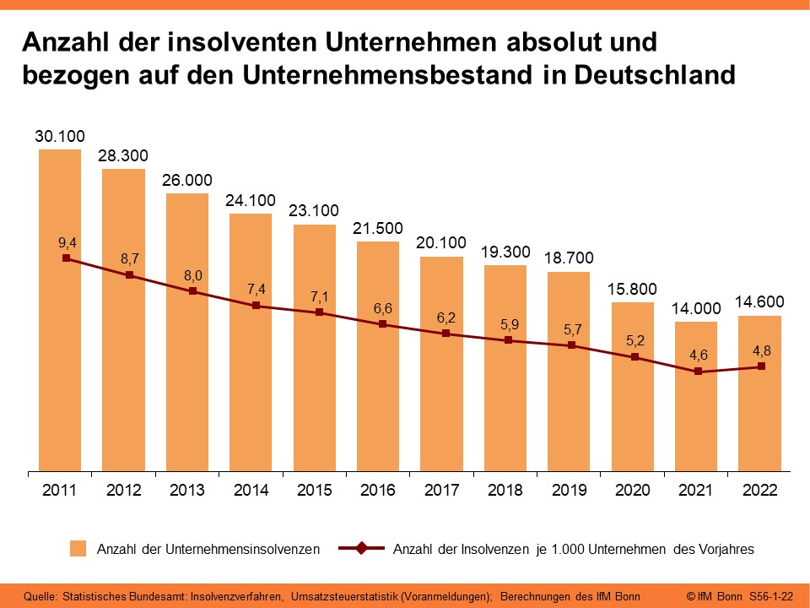
Situation Overview
“German Insolvency Paradox” in times of multiple crises (Corona, geopolitical crises, rising interest rates & inflation, energy crisis, pressure due to digital transformation and climate protection targets, etc.).
→ Turning point (end of) 2022?

Slide 3
Situation Overview
What about the new restructuring tool in the toolbox?
Gesetz über den Stabilisierungs- und Restrukturierungsrahmen für Unternehmen – StaRUG, implementing (EU) 2019/1023 Directive on restructuring and insolvency in Germany

Slide 4
StaRUG: First Practical Experiences
The German market is waiting for precedents!
Only relatively small number of court decisions that have become public so far which may suggest that the StaRUG is off to a slow start.
However, it should not be overlooked that in the course of the general decline in corporate insolvencies, the number of corporate crises triggering restructurings under StaRUG has also declined
Famous German shirtmaker eterna Mode Holding GmbH was the first larger and prominent company that has undergone restructuring under the new restructuring regime (2021)

Slide 5
StaRUG: First Practical Experiences
eterna Mode Holding GmbH – key aspects:
Restructuring Plan provided for a “hair cut” to bondholders and payment of a settlement rate of 12.5% on claims
Investor entry was implemented by the investor taking over shares on the basis of a capital increase provided for in the Restructuring Plan
Restructuring Plan was unanimously approved by the creditors
Exercise of voting right via joint representative as party by virtue of office (also on material bond terms and conditions)
Restructuring Plan confirmation by the court: Oct. 2021

Slide 6
StaRUG: First Practical Experiences
Currently, we experience an increase in restructuring cases, so it is reasonable to expect that the number of StaRUG proceedings will also rise significantly in the foreseeable future
StaRUG picks up pace: LEONI AG, an international automotive company and critical Tier 1 supplier to many global OEMs, has announced on 3 April 2023 that it has agreed on a financial restructuring concept with its banks, a significant number of its noteholders as well as one of its main shareholder as strategic investor.
Such restructuring concept shall be implemented via StaRUG proceedings in the coming months.
Restructuring Plan shall provide for the implementation of certain capital measures pursuant to which the company will receive new liquidity from a capital increase of EUR 150m and will be relieved of financial liabilities of EUR 708m.

Slide 7
Forum Shopping (from a German perspective)

Slide 8
Forum Shopping
The StaRUG, the Dutch WHOA framework, and the UK restructuring plan – Who is ahead?
ADLER – principle witness for the dominance of English law (and legal culture)?
Adler Group holds, manages and develops residential real estate in Germany.
Group external debt of approximately €6 billion, in particular senior unsecured German law-governed notes (the SUNs), originally issued by a Luxembourg entity of the Group

Slide 9
Forum Shopping
ADLER – key aspects
On 12 April 2023, the English High Court sanctioned a UK restructuring plan for Adler, a German real estate company.
The Plan amends six separate series of senior unsecured German law-governed notes (the SUNs)
Issuer Substitution: English NewCo as new borrower, which proposed the UK RP.
There was extensive valuation evidence, including cross-examination of witnesses, however, a pragmatic commercial view has prevailed
Recognition of UK RP in Germany

Slide 10
Current Developments with respect to Insolvency Proceedings

Slide 11
Temporary adjustment of certain restructuring/insolvency law provisions
In the context of rising energy and raw material prices, the German federal government has passed an Act regarding the Mitigation of Consequences of a Crisis under Restructuring and Insolvency Laws (Sanierungs- und insolvenzrechtliches Krisenfolgenabmilderungsgesetz – SanInsKG) which came into force on 9 November 2022
The most important changes under German insolvency law are:
The forecast period for the positive going concern prognosis in the over-indebtedness test is shortened from twelve months to four months
The maximum period granted to a debtor's management for filing for insolvency due to over-indebtedness is extended from 6 to 8 weeks
The period to be covered by the financing plan (Finanzplan) to be submitted by a debtor when filing for opening of debtor-in-possession insolvency proceedings or for StaRUG proceedings, respectively, is reduced from six months to four months, thus easing the debtor's access to debtor-in-possession insolvency proceedings or to (court/out-of-court) StaRUG Proceedings, as the case may be
The statutory amendments under the SanInsKG are initially limited in time until 31 December 2023
Whether the regulations will be extended beyond this date (possibly in an amended version) is not yet foreseeable

Slide 12
Overview: StaRUG Proceedings

Slide 13
Out-of-Court Restructuring Framework
Consensual out-of-court restructuring process; generally requires unanimous approval by the creditors
German Bond Act (Schuldverschreibungsgesetz) (applicable only to bonds issued under German law)
If stipulated in the bond terms, dissenting bondholders can be bound by collective measures that have been approved by qualified majority (usually 75%) of bondholders
On 1 January 2021 the Corporate Stabilisation and Restructuring Act (StaRUG) came into force, which introduced a new restructuring scheme
New regime filled the gap in German restructuring law that existed between consensual pre-insolvency restructuring and formal and comprehensive insolvency proceedings

Slide 14
Overview: StaRUG Proceedings
Consensual Restructuring
Preventive Restructuring Framework (StaRUG)
Insolvency Proceedings
Crisis / imminent illiquidity
Imminent illiquidity
(Imminent) illiquidity /
over-indebtedness
Preventive Restructuring Framework (StaRUG)
Preparation / Negotiation of Restructuring Plan
Initiation of StaRUG Proceedings
Preliminary Review
Moratorium
Appointment of “Restructuring Officer” (Restrukturierungs-beauftragter)
Out-of-court adoption of / voting on
Restructuring Plan
In-court adoption of / voting on
Restructuring Plan
Insolvency proceedings
Solvent liquidation
Court Confirmation
(sustainable) Restructuring failed
Implementing Restructuring Plan
Successful Restructuring

Slide 15
StaRUG Restructuring Framework
Eligibility
In general, all debtors with COMI in Germany are eligible; must be imminently illiquid (drohend zahlungsunfähig) but must not (yet) be illiquid or over-indebted
Suspension of (absolute) duty to file for insolvency
Restructuring Officer
In certain cases the court will appoint a so-called Restructuring Officer; Restructuring Officer supervises restructuring and reports to and is supervised by the Restructuring Court
Moratorium
Debtor may apply to the court for a moratorium on foreclosure and enforcement in order to secure the chances of success of the implementation of a Restructuring Plan (initially be granted for a maximum period of three months and may be extended up to eight months)
Court Confirmation of the Restructuring Plan
Court Confirmation can be requested and will be granted if prerequisites are met (i.e. imminent illiquidity, creditor acceptance, rights of dissenting creditors, qualified absolute priority rule)

Slide 16
StaRUG Restructuring Framework (cont’d)
The Restructuring Plan lies at the heart of the StaRUG Restructuring Framework
Permissible Modifications include:
modifications of liabilities and security rights granted by the debtor as well as the underlying contractual relationships
an impairment of third-party security granted by the debtor’s subsidiaries and
an infringement of shareholder rights, for example in the form of capital measures or the transfer of share or membership rights (including pre-insolvency debt-for-equity swap)
Adoption of Restructuring Plan
Debtor can flexibly choose which (groups of) stakeholders to include; to adopt the plan, a majority of 75% by value of claims within each group is required
Cram-Down: Dissenting class can be “crammed down” if:
majority of classes vote in favor of plan
members of dissenting class can be expected to be no worse off than without plan and
members of dissenting class receive adequate share in value created by the plan
Recognition? EC Insolvency Regulation (public StaRUG) – England (the rule in Gibbs): An English law debt obligation cannot be discharged by a foreign insolvency process

Slide 17
New financings / Effects on lender liability and claw-back
Commitments of new financings and the granting of security for such new financings may also form part of the Restructuring Plan where, on the basis of the business plan, this is necessary to finance the restructuring of the debtor
The provisions of a Restructuring Plan finally sanctioned by the competent restructuring court and the legal actions implementing such a confirmed Restructuring Plan are generally barred from claw-back in a subsequent insolvency
Consequently, such new money financings forming part of a court-sanctioned restructuring plan are also generally excluded from claw-back in a subsequent insolvency
However, the lender liability regime imposed by German case law on turnaround financings is not suspended in its entirety
Further, the StaRUG stipulates that knowledge of an initiation of StaRUG Proceedings does not suffice to imply lender liability or an intention to disadvantage other creditors
Thus, for certain clawback claims, there will no longer be grounds for the insolvency administrator in subsequent insolvency proceedings to challenge certain legal acts only because StaRUG Proceedings had been initiated or because the debtor made use of the respective stabilization and restructuring measures
However, loans granted by and security provided to shareholders are excluded from this stipulations

Slide 18
Dr. Sven-Holger Undritz
White & Case LLP
Valentinskamp 70 / EMPORIO
20355 Hamburg
Germany
T +49 40 808136 212
F +49 40 808136 250

Slide 19
144069862 v1

